Slide 1

WELCOME
COHORT 5
7th Sept – 3rd Dec 2026
Suite 6-6-7, Level 6, Menara MAA

Slide 2
Contents
Introduction to API
Introduction to FastAPI
Endpoints (GET, POST, PUT, DELETE)

Slide 3
What is an API?
Application Programming Interface (API)
A messenger between systems
Frontend never talks directly to the database/backend.
Example:
Customer → Frontend
Waiter → API
Kitchen → Backend

Slide 4
How API communicate?
Via URLs (endpoints)
Each endpoint is a specific address that performs an action.
URL: https://example.com | Endpoint: https://example.com/books
Four common endpoints:
GET – retrieve data
POST – create data
PUT – update data
DELETE – remove data

Slide 5
Introduction to FastAPI
Python framework used to build APIs
Other framework: Django, Flask
Modern, fast, and easy to use
https://fastapi.tiangolo.com/

Slide 6
GET Request
A GET request is an HTTP method used to retrieve data from a server.
Used when a client wants to get information from the server.
Does not change or update any data on the server.
Commonly used to fetch web pages, images, or API data.

Slide 7
POST Request
A POST request is an HTTP method used to send data to a server to create or update a resource.
Unlike a GET request, where data is appended in the URL as query parameters, the data in a POST request is sent within the body of the HTTP request.
Content-Type: application/json
{
  "name": "John Doe",
  "email": "john@example.com",
  "password": "securePassword123“
}

Slide 8
PUT Request
A PUT request is an HTTP method used to update or replace an existing resource on a server.
Unlike a POST request, which is often used to create new resources, a PUT request is generally used to modify or completely replace the content of an existing resource.

Slide 9
DELETE Request
A DELETE request is an HTTP method used to remove or delete a specified resource from a server.
It is one of the fundamental HTTP methods and is designed for deleting resources, such as records in a database, files, or any other data stored on a server.

Slide 10
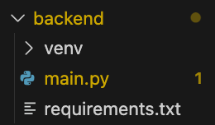
Today’s Folder Structure

Slide 11
Backend Setup
Create a new folder called Backend
Open the folder inside VSC
Inside the folder, create and activate a Virtual Environment
  Function: Avoids version conflicts
    Multiple project , same libraries but different version
| Mac | Windows
Create Virtual Environment | python3 -m venv venv | py -m venv venv Activate Virtual Environment | source venv/bin/activate | venv\Scripts\activate

Slide 12

Backend Setup
3. Inside the folder, create main.py and requirements.txt
4. Add fastapi and uvicorn in requirements.txt.
5. Install everything listed in your requirements file at once using:
pip install -r requirements.txt

Slide 13
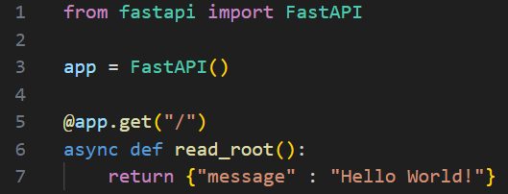
Create Your First API Endpoint
In main.py, create an endpoint.
Decorator to define an API endpoint that responds to GET request

Slide 14
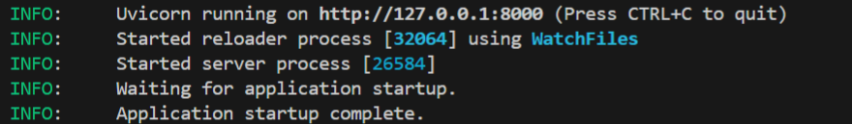
Create Your First API Endpoint
Activate the uvicorn server: uvicorn main:app --reload
Decorator to define an API endpoint that responds to GET request

Slide 15
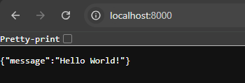
Create Your First API Endpoint
Go to the web browser, type localhost:8000 in the address bar

Slide 16
Today..
You are a librarian managing a library
Your task for today:
List All Books (using GET)
  Find Book by Title - Path Parameter
  Find Book by Author - Query Parameter
  Find Book by Author and Published Year - Query Param.
Add New Book (using POST)
Update Old Book (using PUT)
Delete Book (using DELETE)

Slide 17
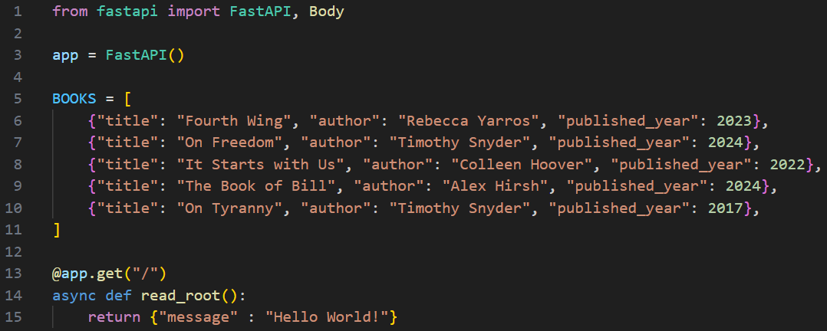
1. List All Book
Step 1: Create a list of the book objects in the main.py
Notes:
BOOKS = [
{"title": "Fourth Wing", "author": "Rebecca Yarros", "published_year": 2023},
{"title": "On Freedom", "author": "Timothy Snyder", "published_year": 2024},
{"title": "It Starts with Us", "author": "Colleen Hoover", "published_year": 2022},
{"title": "The Book of Bill", "author": "Alex Hirsh", "published_year": 2024},
{"title": "On Tyranny", "author": "Timothy Snyder", "published_year": 2017},
]

Slide 18
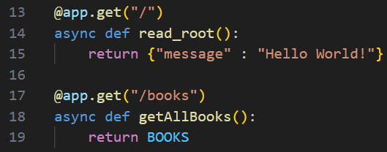
1. List All Book
Step 2: Create a GET request endpoint

Slide 19
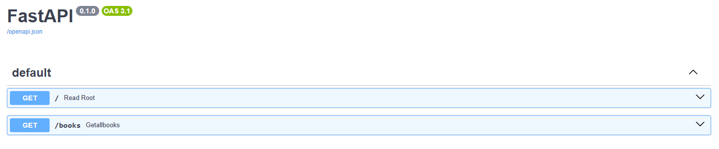
1. List All Book
Step 3: In the browser address bar, type localhost:8000/docs

Slide 20
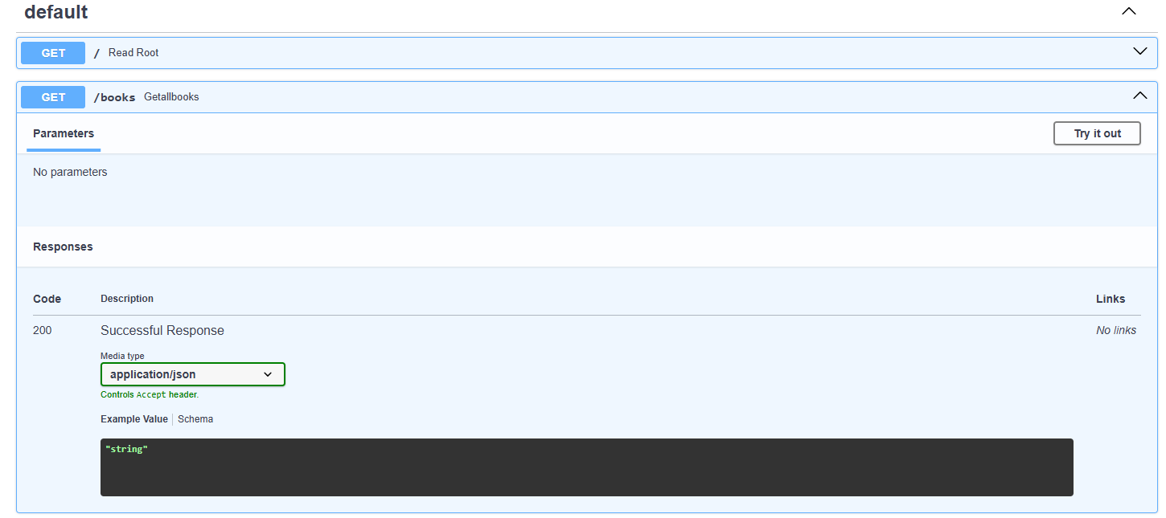
1. List All Book
Step 4: Click Try It out button

Slide 21
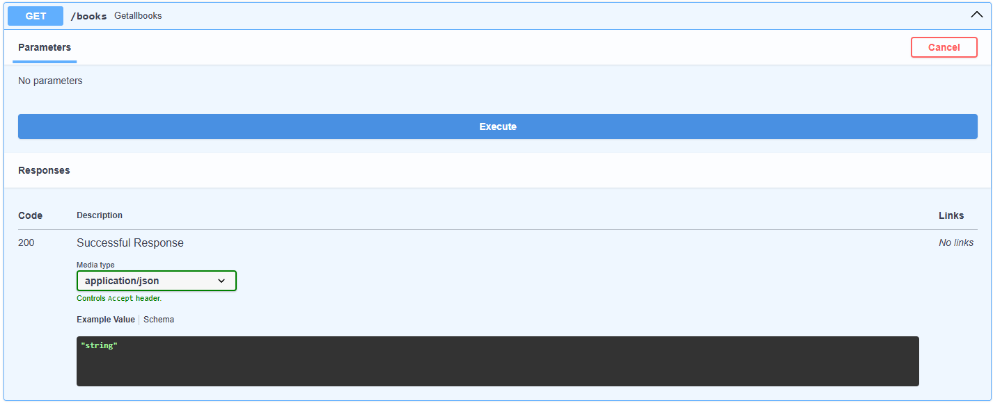
1. List All Book
Step 5: Click the Execute button
Click

Slide 22
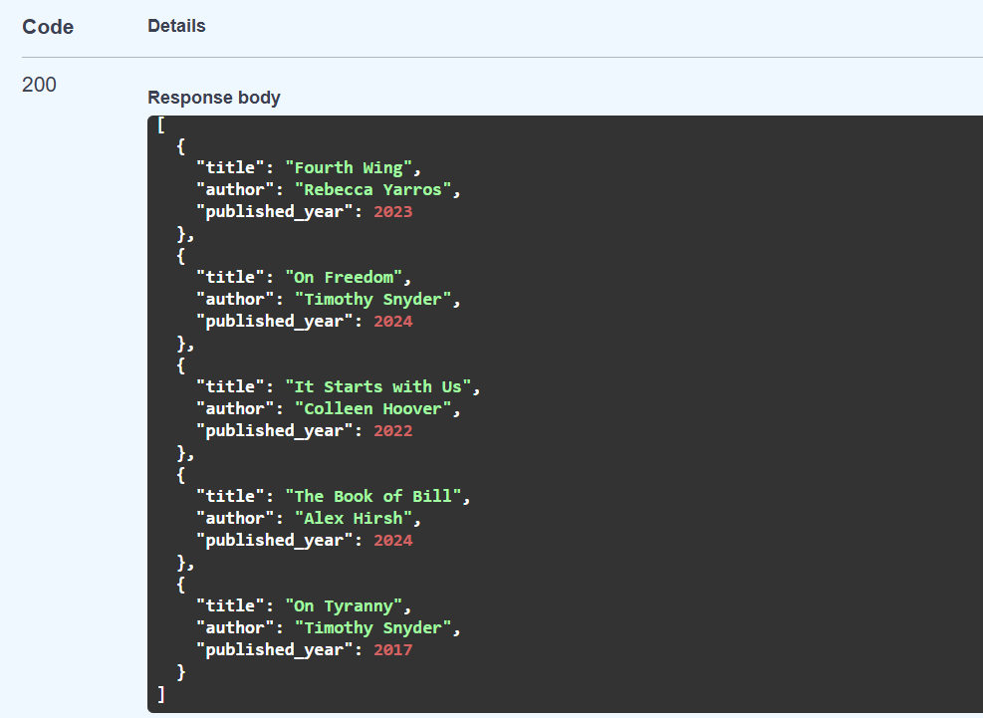
1. List All Book

Slide 23
Path Parameter
Part of the URL and identify a specific resource.
Use when:
  Finding a specific item
https://api.example.com/users/123
Path Parameter

Slide 24
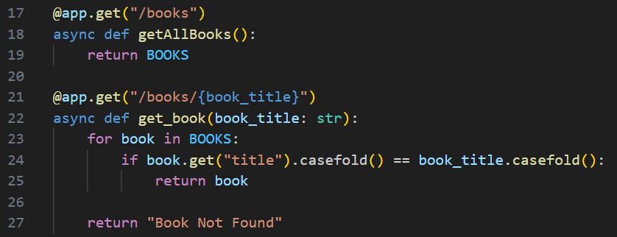
  Find Book by Title - Path Parameter
Step 1: In main.py, create an endpoint with a path parameter for book title
Path Parameter

Slide 25
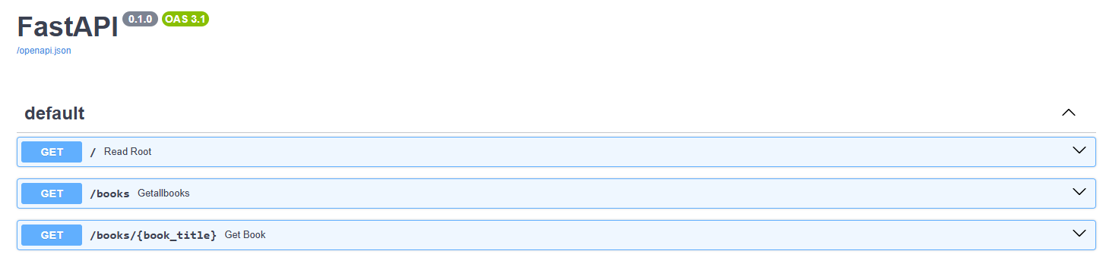
  Find Book by Title - Path Parameter
Step 2: From the Swagger UI in browser, click the endpoint with path parameter for book title.

Slide 26
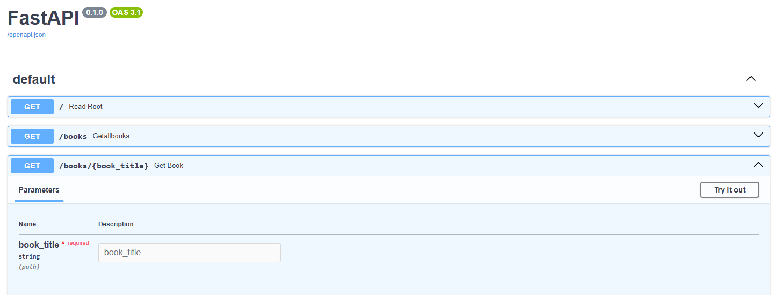
  Find Book by Title - Path Parameter
Step 3: Click the Try it out button

Slide 27
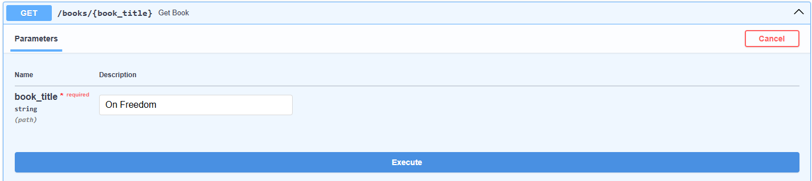
  Find Book by Title - Path Parameter
Step 3: Type “On Freedom” on the book_title field and click the “Execute” button

Slide 28
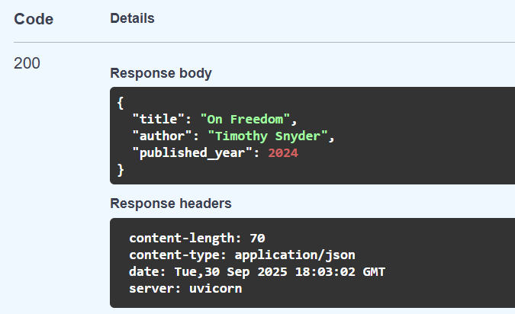
  Find Book by Title - Path Parameter

Slide 29
Query Parameter
Extra information into the URL.
Use when
  Filtering
  Searching
  Optional data
https://example.com/page?key1=value1&key2=value2

Slide 30
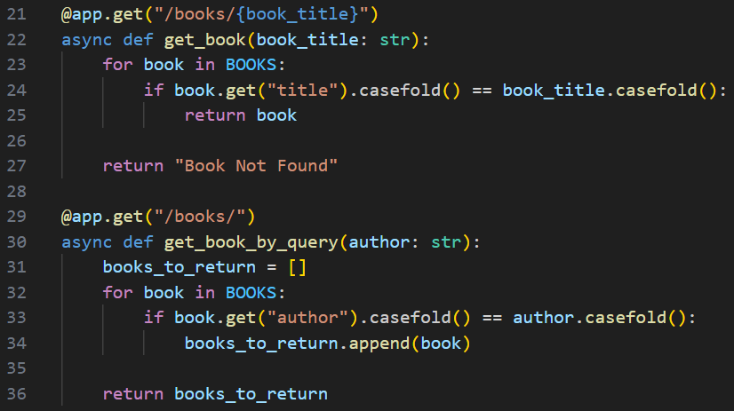
b. Find Book by Author - Query Parameter
Step 1: In main.py, create an endpoint with a query parameter for book author

Slide 31
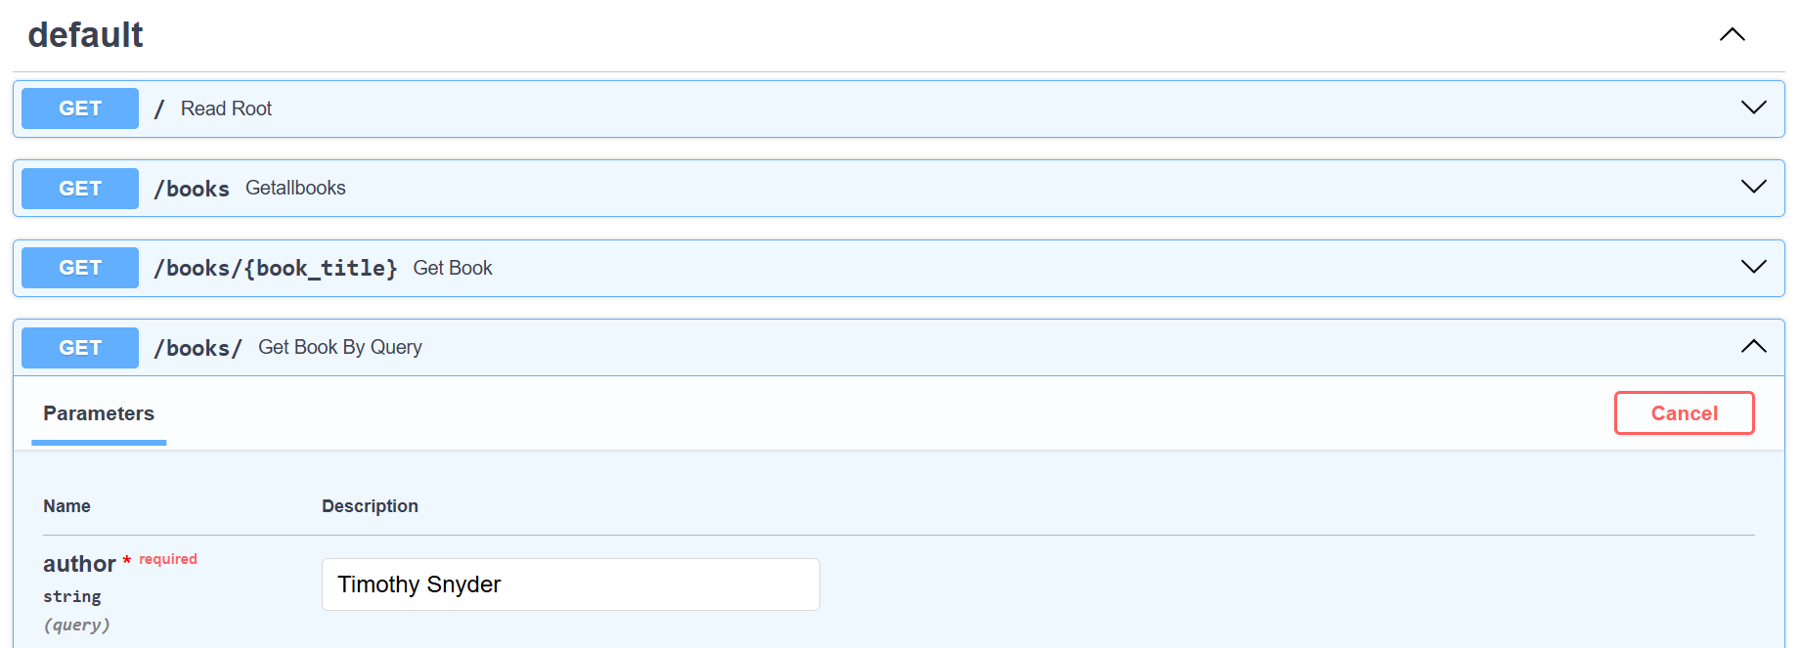

b. Find Book by Author - Query Parameter
Step 2: In the FastAPI Swagger, test the API endpoint with author name “Timothy Snyder”

Slide 32
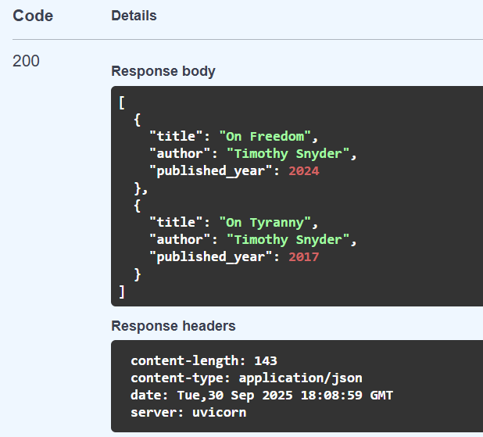
b. Find Book by Author - Query Parameter

Slide 33
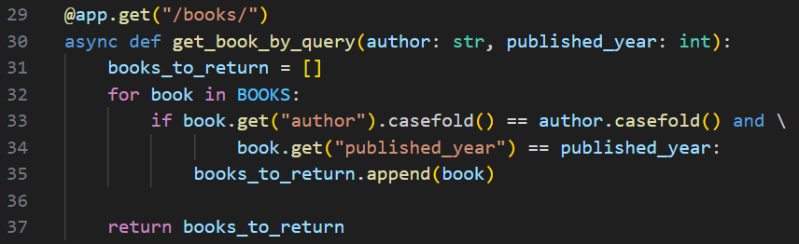
c. Find Book by Author and Published Year
Step 3: In main.py, add another query parameter for book published year

Slide 34
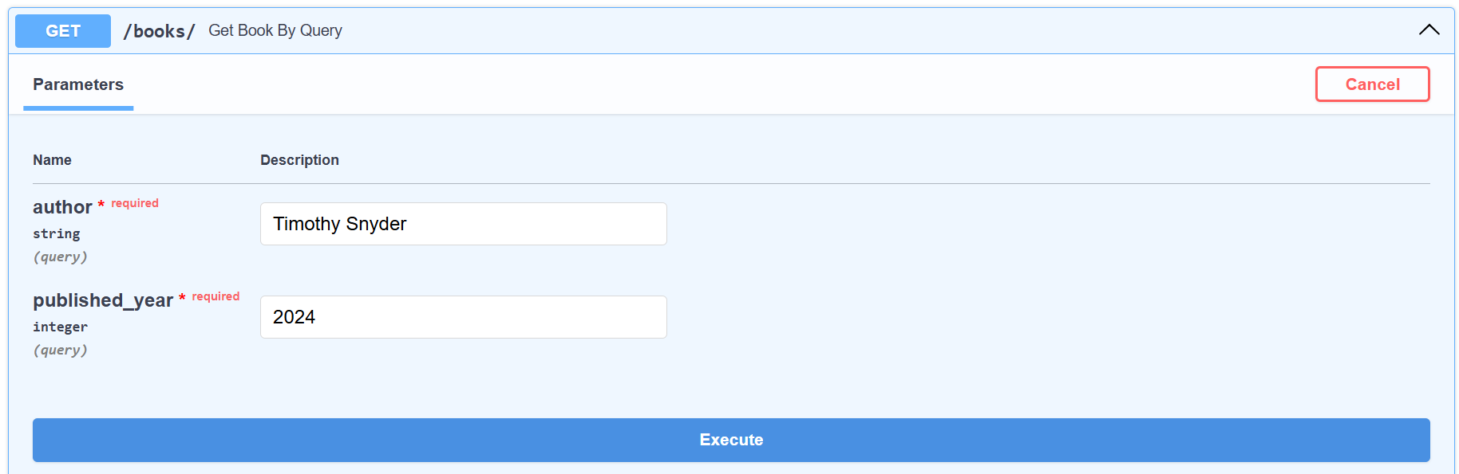
Create an Endpoint with Query Parameter(s)
Step 4: In the FastAPI Swagger, test the API endpoint with author name “Timothy Snyder” and published year 2024

Slide 35
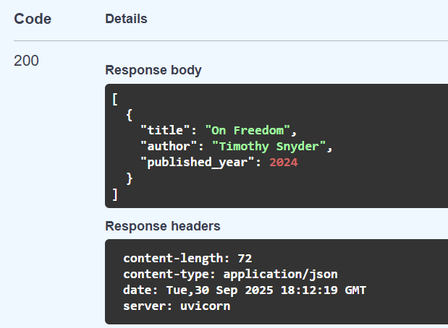
Create an Endpoint with Query Parameter(s)

Slide 36
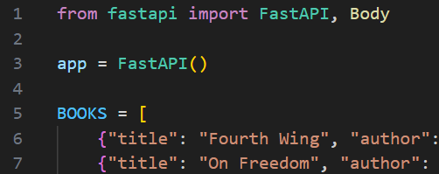
2. Add New Book (using POST)
Step 1: In main.py, import another module named “Body”

Slide 37
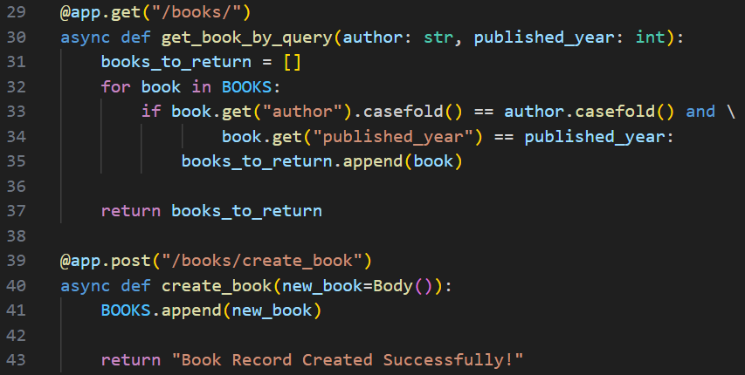
2. Add New Book (using POST)
Step 2: Create a post request endpoint to add a new book record to the Python list.

Slide 38
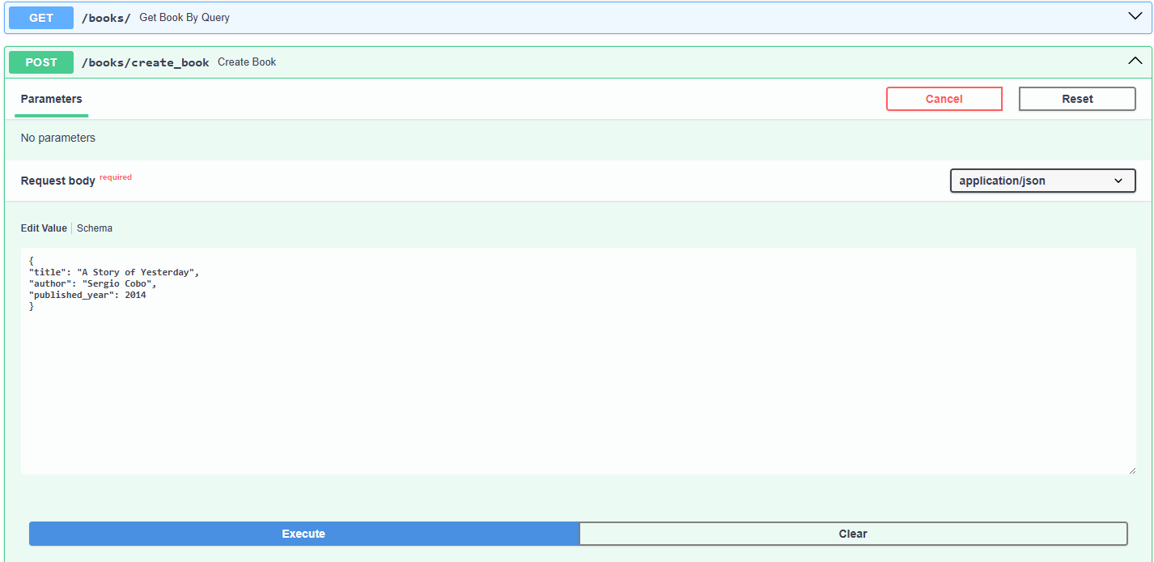
2. Add New Book (using POST)
Step 3: In Swagger UI, test the post request endpoint with a new book record.
{
  "title": "A Story of Yesterday",
  "author": "Sergio Cobo",
  "published_year": 2014
}

Slide 39
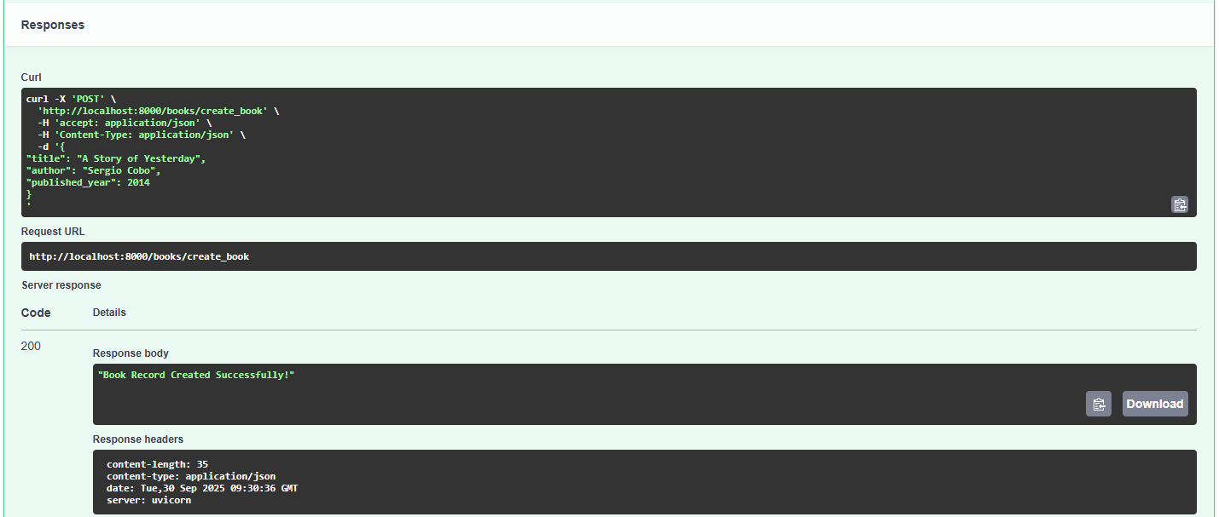
2. Add New Book (using POST)

Slide 40
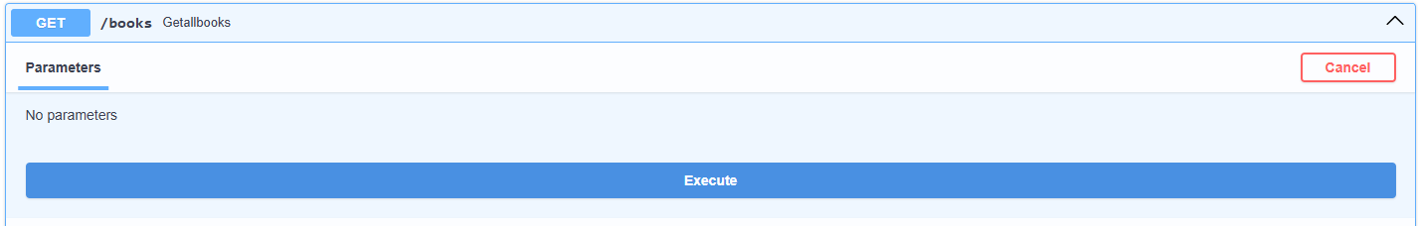
2. Add New Book (using POST)
Step 4: In Swagger UI, test the earlier created get request endpoint to retrieve all the book records.

Slide 41
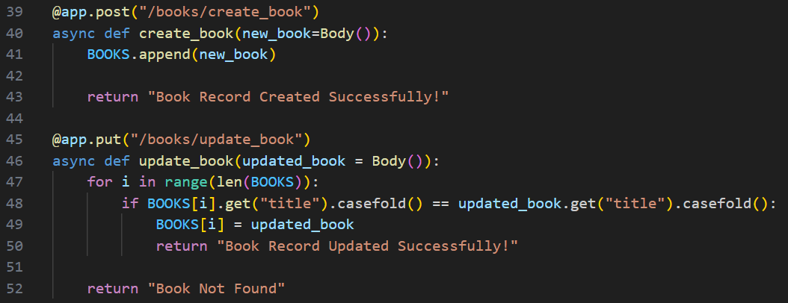
3. Update Old Book (using PUT)
Step 1: In main.py, create a put request endpoint to update a book record
Notes:
Receive updated book data
↓
Loop through BOOKS
↓
Find matching title
↓
If found:
↓
Replace old data
↓
Return success
↓
End
If not found:
↓
Return error
↓
End

Slide 42
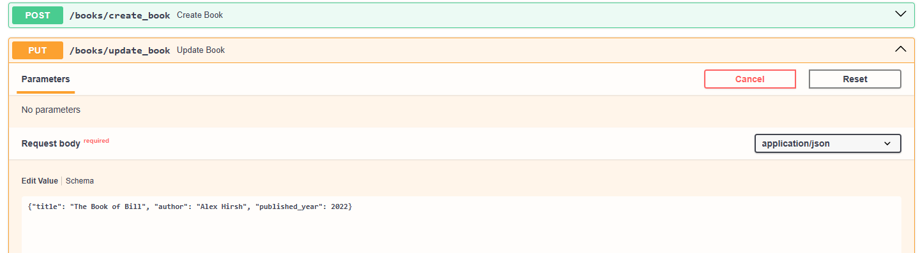
3. Update Old Book (using PUT)
Step 2: In the Swagger UI, test the put request endpoint by changing the published year of “The Book of Bill” from 2024 to 2022.
Notes:
{"title": "The Book of Bill", "author": "Alex Hirsh", "published_year": 2024}

Slide 43
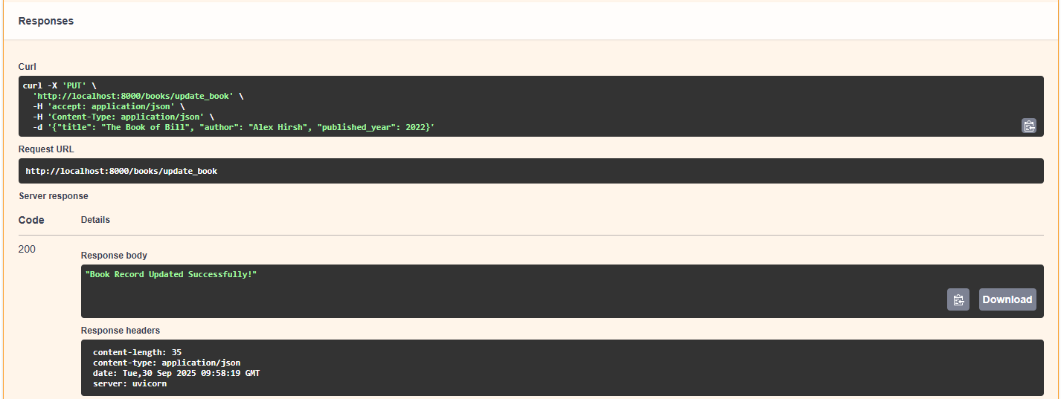
3. Update Old Book (using PUT)

Slide 44
3. Update Old Book (using PUT)
Step 3: In Swagger UI, test the earlier created get request endpoint to retrieve all the book records.

Slide 45
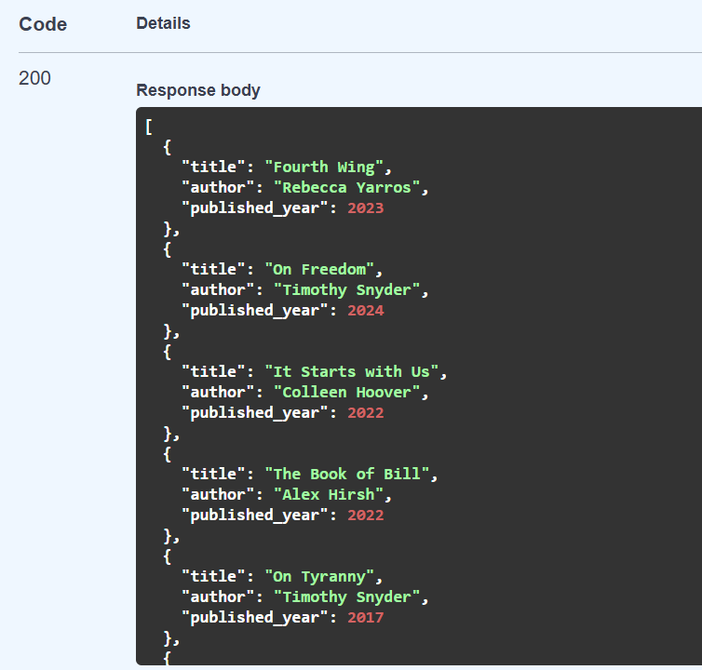
3. Update Old Book (using PUT)
The published year has been updated from 2024 to 2022

Slide 46
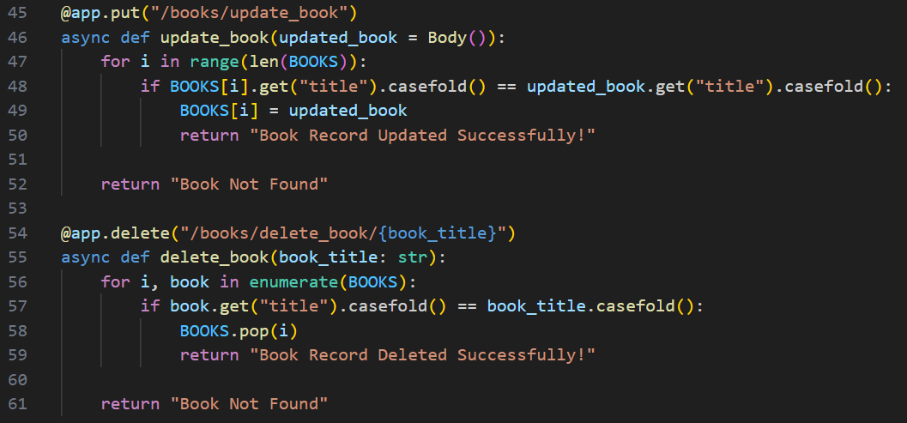
4. Delete Book (using DELETE)
Step 1: In main.py, create a delete request endpoint to delete a book record by title.
Notes:
Receive book title from URL (path parameter)
↓
Loop through BOOKS with index (i)
↓
Check if book title matches
↓
If match found:
↓
Remove book from list (BOOKS.pop(i))
↓
Return "Book Record Deleted Successfully!"
↓
End
If no match found after loop:
↓
Return "Book Not Found"
↓
End

Slide 47
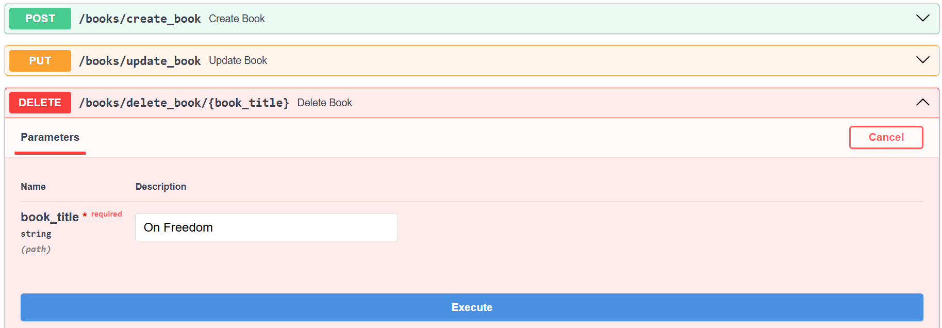
4. Delete Book (using DELETE)
Step 2: In the Swagger UI, test the delete endpoint by removing a book titled “On Freedom”.

Slide 48
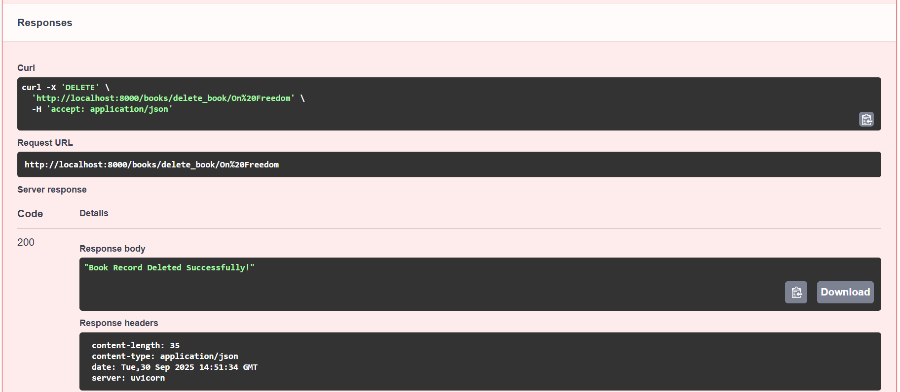
4. Delete Book (using DELETE)

Slide 49
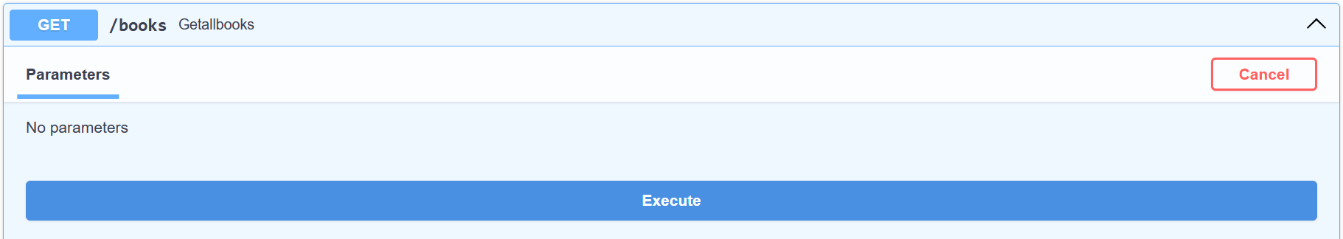
4. Delete Book (using DELETE)
Step 3: In Swagger UI, test the earlier created get request endpoint to retrieve all the book records.

Slide 50
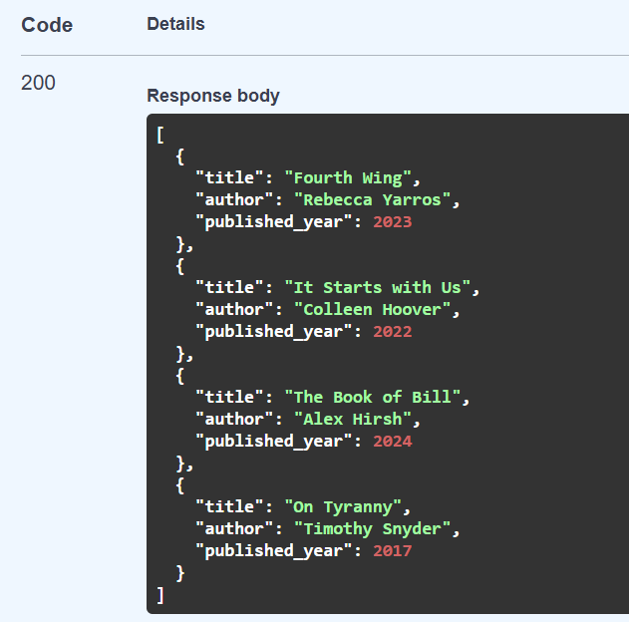
4. Delete Book (using DELETE)

Slide 51
Status Codes
Status codes are international standards on how a client/server should handle the result of a request.
It allows everyone who sends a request to know if their submission was success or not.

Slide 52
Status Codes
Codes | Meaning
1xx | Information Response: Request processing
2xx | Success: Request successfully complete
3xx | Redirection: Further action must be complete
4xx | Client Errors: An error was caused by the client
5xx | Server Errors: An error occurred on the server

Slide 53
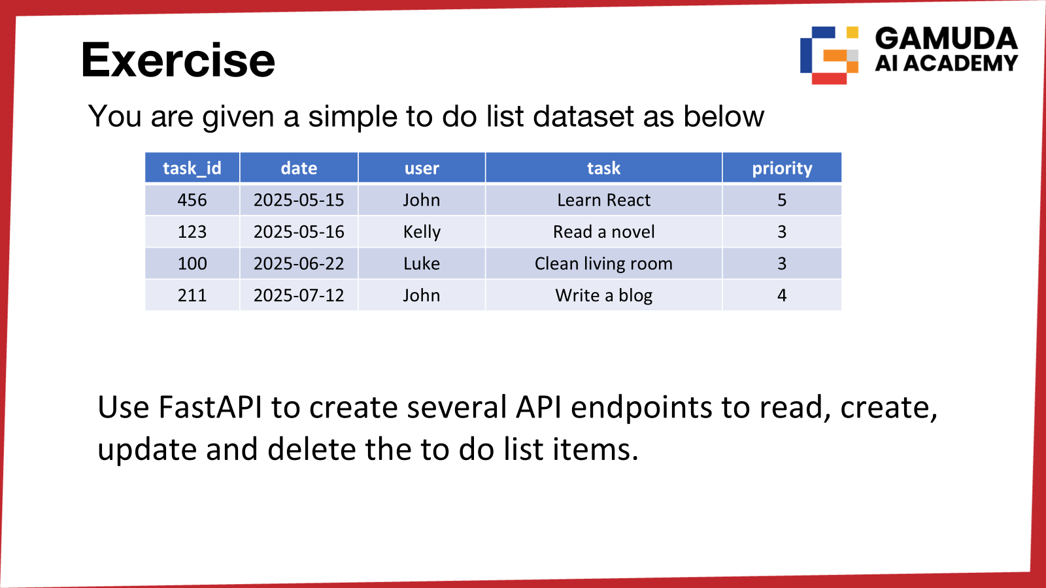

Slide 54


